Slide 1
Blockchain in education
November 2018
Alex Kaplan, Global Leader, Strategic Deals, Watson Education; Member, IBM Industry Academy

Slide 2



By strengthening our trust, we change the world
What can we do together?

Slide 3
The IBM Blockchain platform
A fully integrated enterprise-ready blockchain platform designed to accelerate the development, governance, and operation of a multi-institution business network
Developer tools make use of Hyperledger Composer to quickly build blockchain application
Hyperledger Fabric provides the ledger, managed through a set of operational tools
Governance tools for democratic management of the business network
The highly secure and performant IBM Cloud™ environment
Blockchain application
Hyperledger Composer
Developer Tools
Operational Tools
Governance Tools
Hyperledger Fabric
IBM Cloud
Network convening power
IBM provides global leadership in education and blockchain.
IBM Blockchain platform
IBM’s depth and breadth of blockchain technical and industry experience is an essential aspect of success.
Technical expertise
IBM depth and breadth of expertise leads the education industry in blockchain transformation.
Roadmap for the future
IBM’s guidance on education blockchain will assist the industry in growing its network.

Slide 4

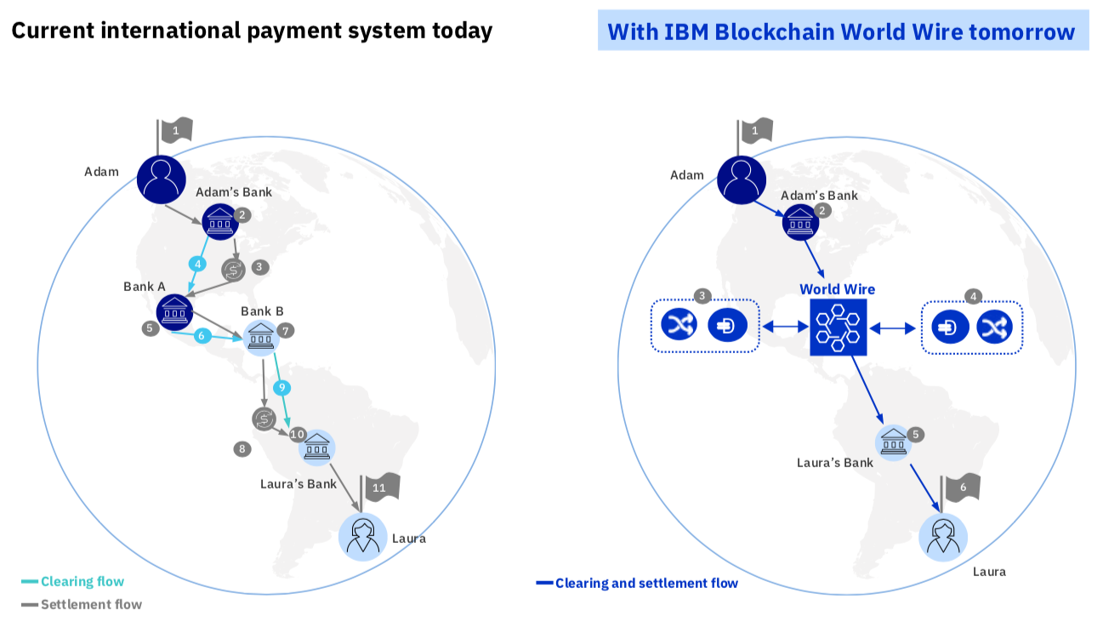

Tackling difficult problems with IBM Blockchain
World Wire—Make cross border payments cheaper and faster
Food Trust—Provide trusted information traceability to food
Legitimize diamonds and reduce fraud
Current international payment system today
With IBM Blockchain World Wire tomorrow

Slide 5
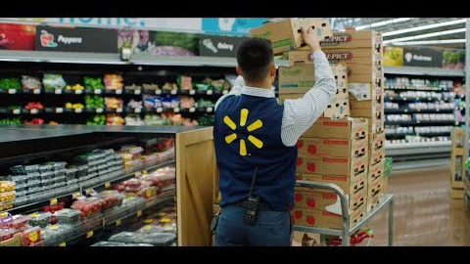
IBM Food Trust

Slide 6
We’re entering a new age of education
Education must address the technological disruption upon us.
Trust disruption
Trusted communications and information are more important than ever—but serious challenges remain.
Data disruption
Data is the world’s next natural resource— we need to put it to good use.
Business disruption
Future collaboration with new kinds of partners will be required—future growth depends upon it.

Slide 7
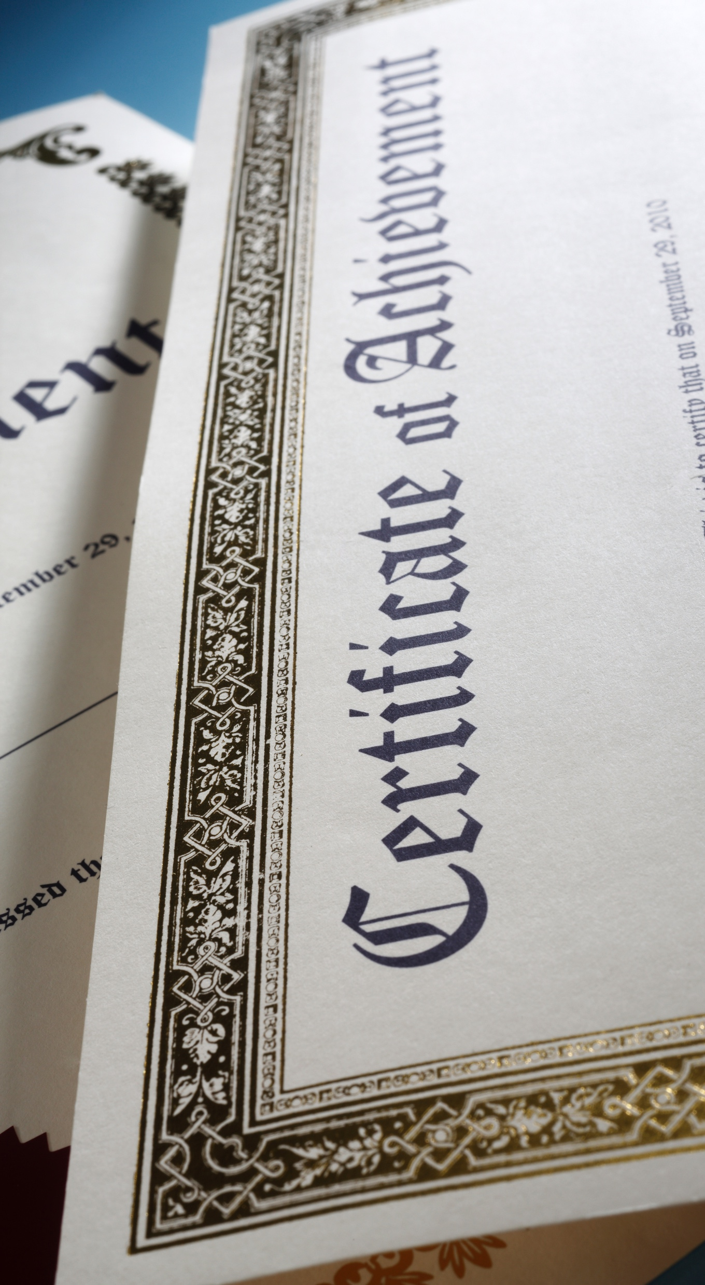
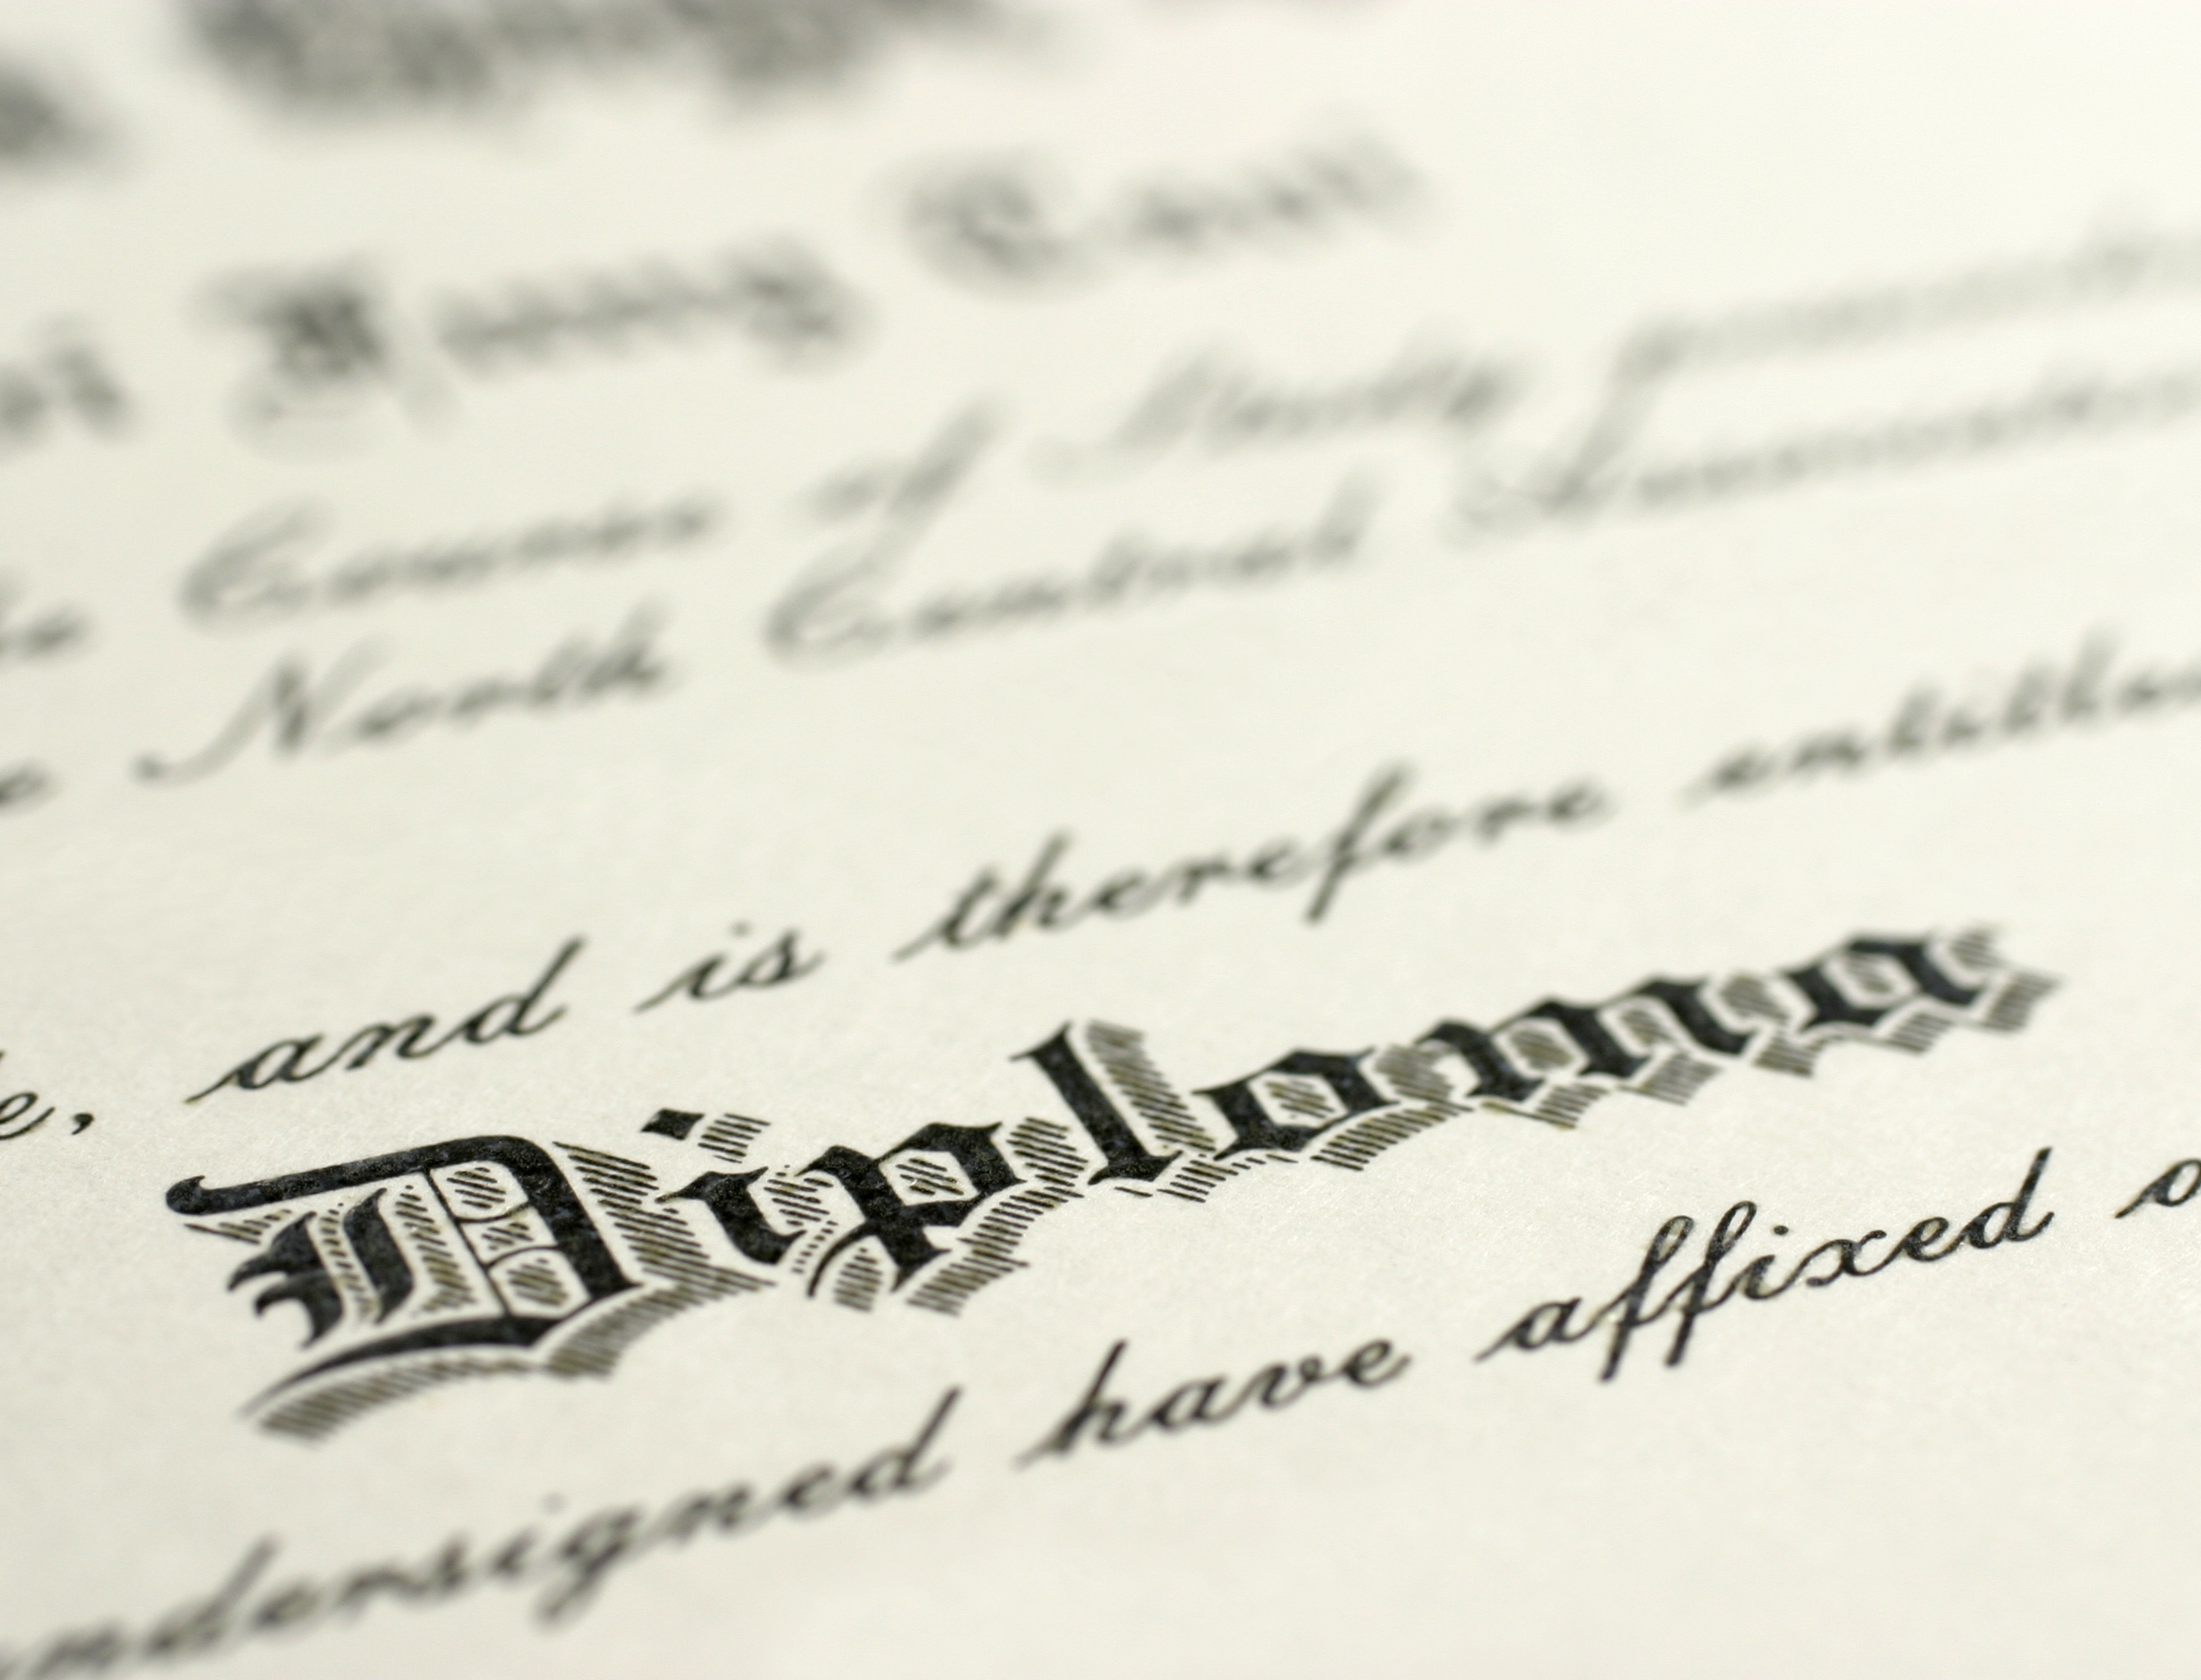
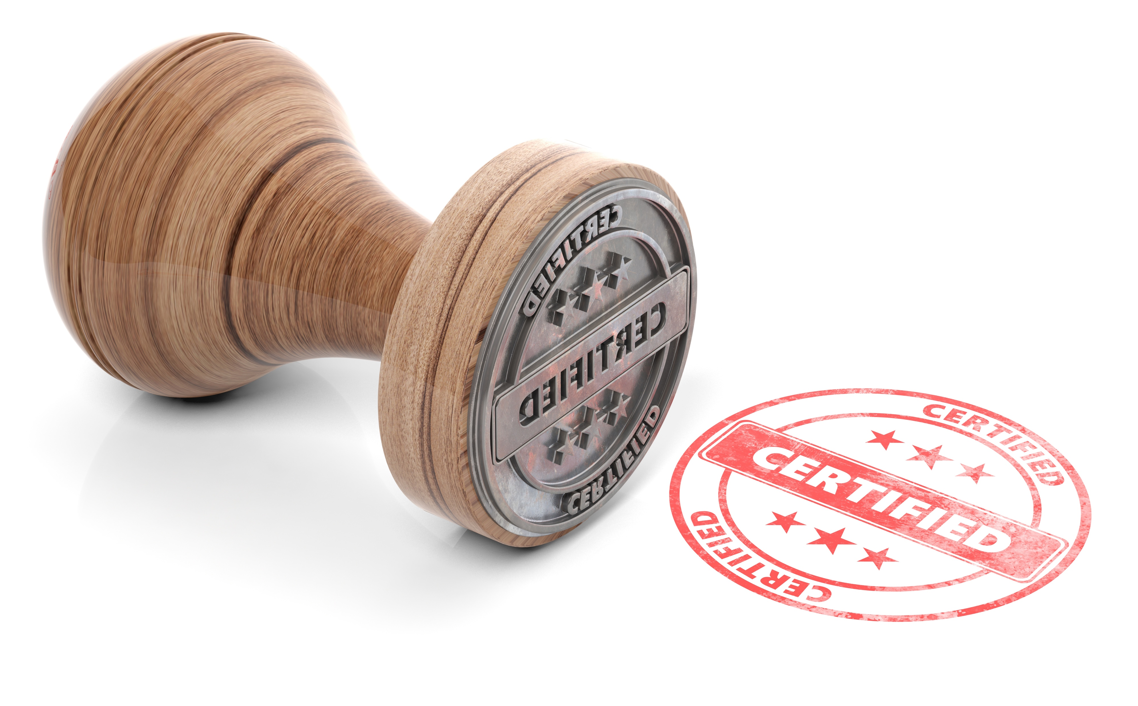

Credentials unlock the value of our experiences
Credentials are evidence of mastery of skill.
Credentials are issued by 1000s of organizations.
Mastery can be demonstrated through transcripts, badges, course work, experience, hobbies, relationships and work.
The emerging concepts of micro-credentials and stackable micro-credentials can unlock their value.

Slide 8
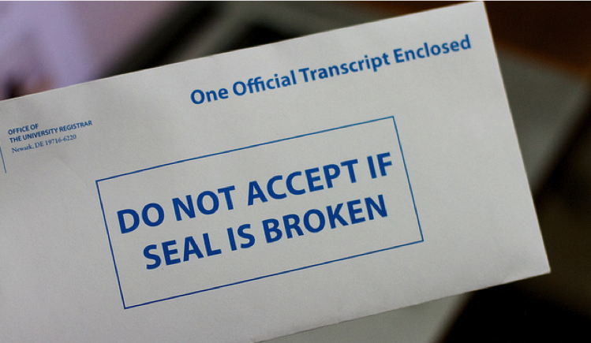
Managing skills credentials is inefficient, expensive, open to fraud and too high level
Manual, paper-based processes, including official “sealed” envelopes are insecure.
Employers report significant trust problems.
Education stakeholders incur high costs from academically struggling students resulting in lost tuition or costly remediation.
Historically costly and slow transfer of credits inhibits efficient use of credits and credentials for transfers, jobs, and so forth.
Current credentials processes are impeding the evolution of new and valuable solutions to help all learners across their lifetime of learning.

Slide 9
To unlock the value of credentials we need to address their current weaknesses
Reducing costs
Verifying, assessing and qualifying credentials is costly and inefficient.
Trust and fraud
Twenty percent of applicant degree credentials are reported to be inaccurate.
Regulatory requirements
Professional licensing and ongoing credentialing by state or national authorities is inefficient and expensive.
Pathways to employment
Personalized learning pathways are complex and inefficient due to challenges with historical credentials.
Empowered learners
Learners have weak insight to their accumulated skills causing difficulty in charting pathways to education and employment.
Transparency and insight
Lack of insight into credentials impedes critical decisions around admissions, employment and personal learning pathways.

Slide 10
Unlocking the value of credentials is an industry wide challenge
A large number of participating organizations with a variety of roles
Institutions are interacting in a variety of relationships
Members need to do secure transactions and verify the correctness and currency of key data
College

Slide 11
Blockchain technologies solve the credential challenge
But the solutions are larger than any one institution can tackle on its own.
Blockchain is a team sport.
Enabling trust in credentials
Blockchain technology creates radical transparency, fundamentally transforming how we interact, transact and grow business processes.
New revenue streams based upon credentials
More than a new technology, blockchain is rewriting how we do business.
Removing barriers
IBM Blockchain creates certainty, advances knowledge, brings together industries, and improves business processes.
Reinventing education
Blockchain results in more efficient business processes— and creates new business opportunities for all.
66%
of organizations already active on blockchain are experimenting with the business model that connects people, resources and organizations in an ecosystem*
*IBM Institute for Business Value, May 2017

Slide 12
A credential blockchain: the transformative technology to unlock their value
“ A shared, replicated, permissioned ledger with consensus, provenance, immutability and finality for credentials*”
Regulator
Professional certification
Regulatory compliance
Articulations
Built on existing education industry and technical standards
Founded by key education institutions and leaders of the education industry
Supporting all credential use cases
Available to all stakeholders working with credentials
Education Institutions
Academic learning profile
Course offering
Certifications
Credit transfer
Business
View academic profile
Verify certifications
Micro-credentials
Recruitment
Learner
Personal learning pathways
Career pathways
Credentials
Jobs
Education service provider
Credentials
Content
Learning platforms
* “Blockchain: What It Is, What It Does, and Why You Probably Don’t Need One” David Andolfatto, Economic Research Federal Reserve Bank of St Louis, Vol. 100, No. 2 Posted 2018-04-16
Government
Education provider accreditation
Regulatory compliance
Funding determination

Slide 13
Technology skills professional credentialing with IBM Blockchain
Credentialing with blockchain reduces paper processes, speeding up transaction times and increasing efficiency.
Rebecca is studying at the university
The university issues a BS credential on the blockchain network
Rebecca works at IBM®. She passes the certification and is issued an IBM Blockchain Foundation for Developers credential on the blockchain network
Rebecca’s credentials are on the blockchain network along with everyone else’s, creating a single, tamper-resistant ledger
She completes her Bachelor of Science in Software Engineering
Once an organization issues a credential, it cannot be altered
Her manager wants to verify her credentials. Rebecca’s BS and Blockchain credentials are easily traced back to the organizations that issued them

Slide 14
Thank you

Slide 15
© Copyright IBM Corporation 2018. All rights reserved. The information contained in these materials is provided for informational purposes only, and is provided AS IS without warranty of any kind, express or implied. Any statement of direction represents IBM's current intent, is subject to change or withdrawal, and represents only goals and objectives. IBM, the IBM logo, and other IBM products and services are trademarks of the International Business Machines Corporation, in the United States, other countries or both. Other company, product, or service names may be trademarks or service marks of others.

